Slide 1
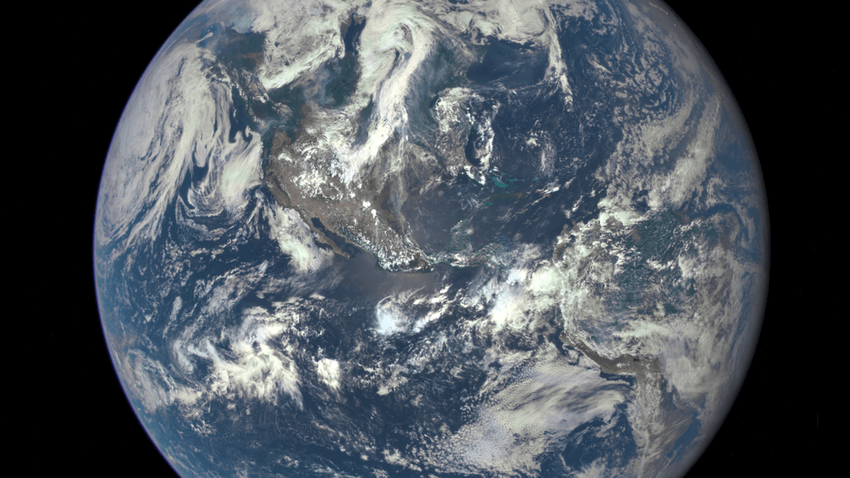
Data Analysis of CO₂ Concentrations (2014-2024)
Angel Antwi-Mensah and Favour Umejesi
DA 101

Slide 2
Introduction and Data Description
This project utilizes a dataset from Kaggle, containing daily atmospheric carbon dioxide (CO₂) concentration measurements spanning October 11, 2014, to November 26, 2024. The data was acquired through the Daily Atmospheric Carbon Dioxide Concentration API from Rapid API (global-warming.org).
By analyzing this dataset, we aim to monitor long-term trends in atmospheric CO₂ levels and seasonal variations. This analysis will provide insights into the relationship between CO₂ trends and global climate patterns, highlighting the influence of human activities on the Earth's atmospheric composition and their broader implications for climate change.

Slide 3

Descriptive Analysis
Used summary(co2_concentration) to spot trends that existed in the columns of the dataset.
Mean
Median
Maximum value for Carbon Dioxide levels (trend) was 420.0ppm (year 2024)
Minimum value for Carbon Dioxide levels (trend) was 396.6ppm (year 2014)
Also used Z Score to help analyze the variability in the trend column of the dataset. .i.e. distance of data points from mean

Slide 4
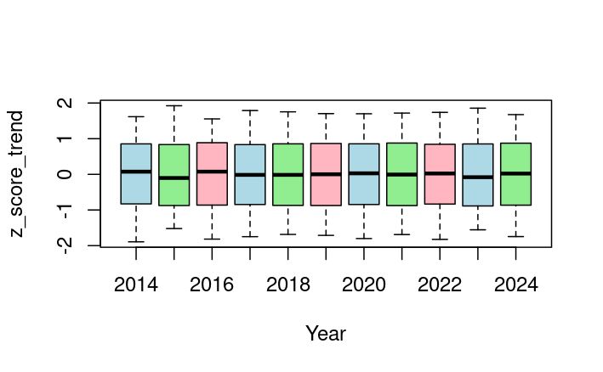
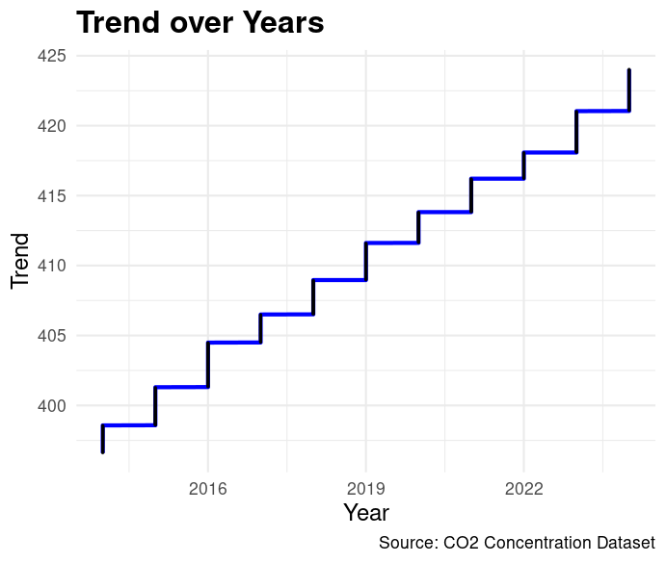
Visualizations

Slide 5
Model Creation and Insights
Built a multiple linear regression model with trend as the response variable and year, season and month as predictors, avoiding multicollinearity.
During model evaluation; achieved an R-squared value of 0.9980, Residual Standard Error of 0.3423, and MSE of 0.117, all reflecting the high accuracy of the model that was built.
Used Season and month to be able to capture short-term variations in the creation of a comprehensive model.
Fun Fact: Used the model to predict the values of Carbon Dioxide Levels for next year!
(The model’s predictions are highly reliable, with an estimated accuracy of over 80%, providing reliability in these projections. )

Slide 6
Conclusion
CO₂ concentrations have steadily increased over the last decade without significant acceleration or anomalies, reflecting the impact of human activities, and are projected to continue rising, reaching an average of 424.84 ppm in 2025.
This consistent upward trend highlights the ongoing challenge of addressing climate change.
To help reduce this trend, it is crucial to implement and support sustainable practices, such as reducing fossil fuel consumption and increasing reforestation efforts.
THANK YOU ALL!
Sources: Kaggle, Environmental Protection Agency (EPA)

